Slide 1

Embryonic Development
The first trimester of pregnancy

Slide 2
Objective
Describe the first trimester of pergnancy

Slide 3
Pregnancy
Pregnancy is the period from conception to birth, when a woman carries a developing fetus in her uterus.
The normal duration of a human pregnancy is 265 days from conception to birth.
(the more usual calculation of 280 days - 40 weeks - is from the first day of the last menstrual period).

Slide 4
Terminology
The pregnancy is broken down into three trimesters, each being three months .
In humans, an embryo refers to the developing organism from the time of conception until the end of the eighth week, after which it is known as a foetus

Slide 5
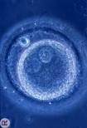
Zygote
Fertilization takes place in the upper part of the Fallopian tube
(uterine tube/ovarian duct)
When an ovum is fertilized it becomes the diploid zygote
[ Zygote - The diploid cell resulting from the fusion of a sperm and an egg ]

Slide 6
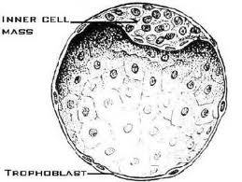
Blastocyst
After fertilisation, the zygote undergoes rapid division. (cleavage)
By Day 5 -7 it forms a hollow ball of cells, with a mass of cells to one side: the Blastocyst
The blastocyst consists of about 100 cells. The outer cell layer will form the placenta
- the inner cell mass forms the embryo

Slide 7
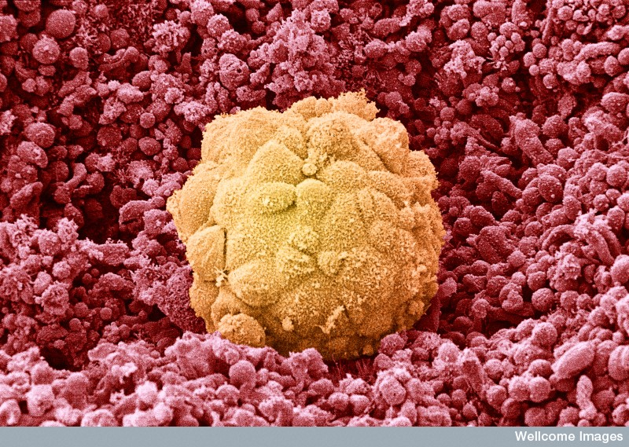
Blastocyst implanting into the endometrium
A SEM of a six-day old human blastocyst implanting into the endometrium
Wellcome Images - Yorgos Nikas

Slide 8
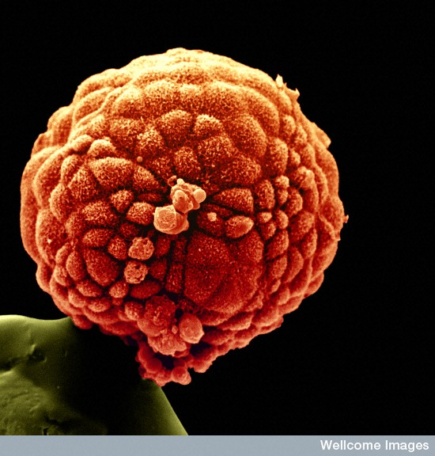
SEM of a human embryo - 5 days on tip of pin
Yorgos Nikas, Wellcome Images

Slide 9
Fertilisation to Implantation
Fertilised egg = Zygote
2n chromosome
Fertilisation occurs in fallopian tube.
Zygote moved towards uterus by muscular contractions and action of cilia.
Zygote cells begin mitotic division, eventually forming a ball of cells
Ball of cells becomes a hollow sphere with a mass of cells to one side
Notes:
http://www.youtube.com/watch?v=UgT5rUQ9EmQ

Slide 10
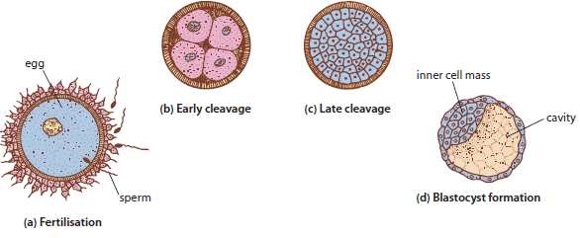
Fertilisation to Implantation
trophoblast
Blastocyte implants itself in uterine wall at about 16 days
Notes:
http://www.youtube.com/watch?v=UgT5rUQ9EmQ

Slide 11
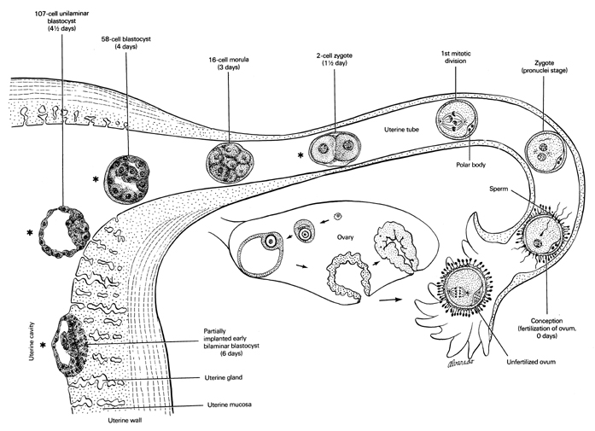

Slide 12
After implantation:
Trophoblast cells begin to form the placenta
The inner cell mass begins to differentiate.

Slide 13
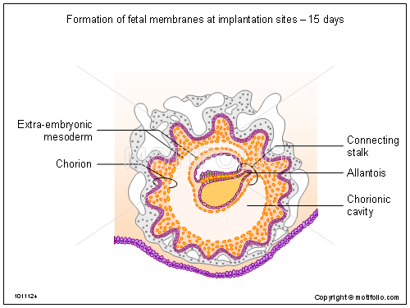
15 days after conception:
The trophoblast is beginning to form a placenta
The inner cell mass has formed:
  An amniotic sac
  A yolk sac
  The allantois, which will become the umbilical cord
  And
  A disc made of three layers of cells. This will become the embryo.

Slide 14
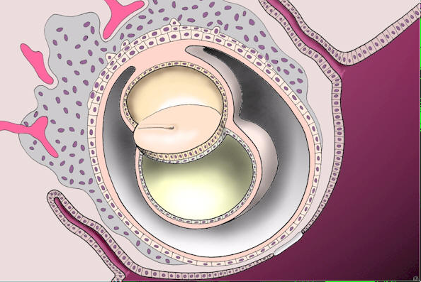
A closer look at the embryonic disc
This disc will develop into the embryo.
3 primary germ layers:

Slide 15
The Germ Layers
Form in the second week of development three layers of cells form from which the various tissues and organs of the body will be derived
The three layers are the ectoderm, mesoderm and endoderm

Slide 16
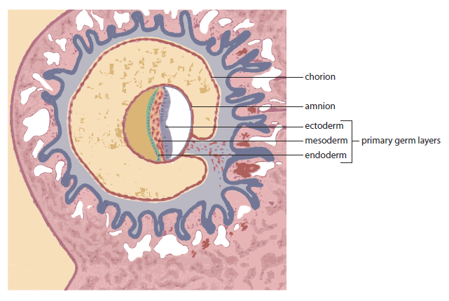
Formation of embryonic germ layers

Slide 17
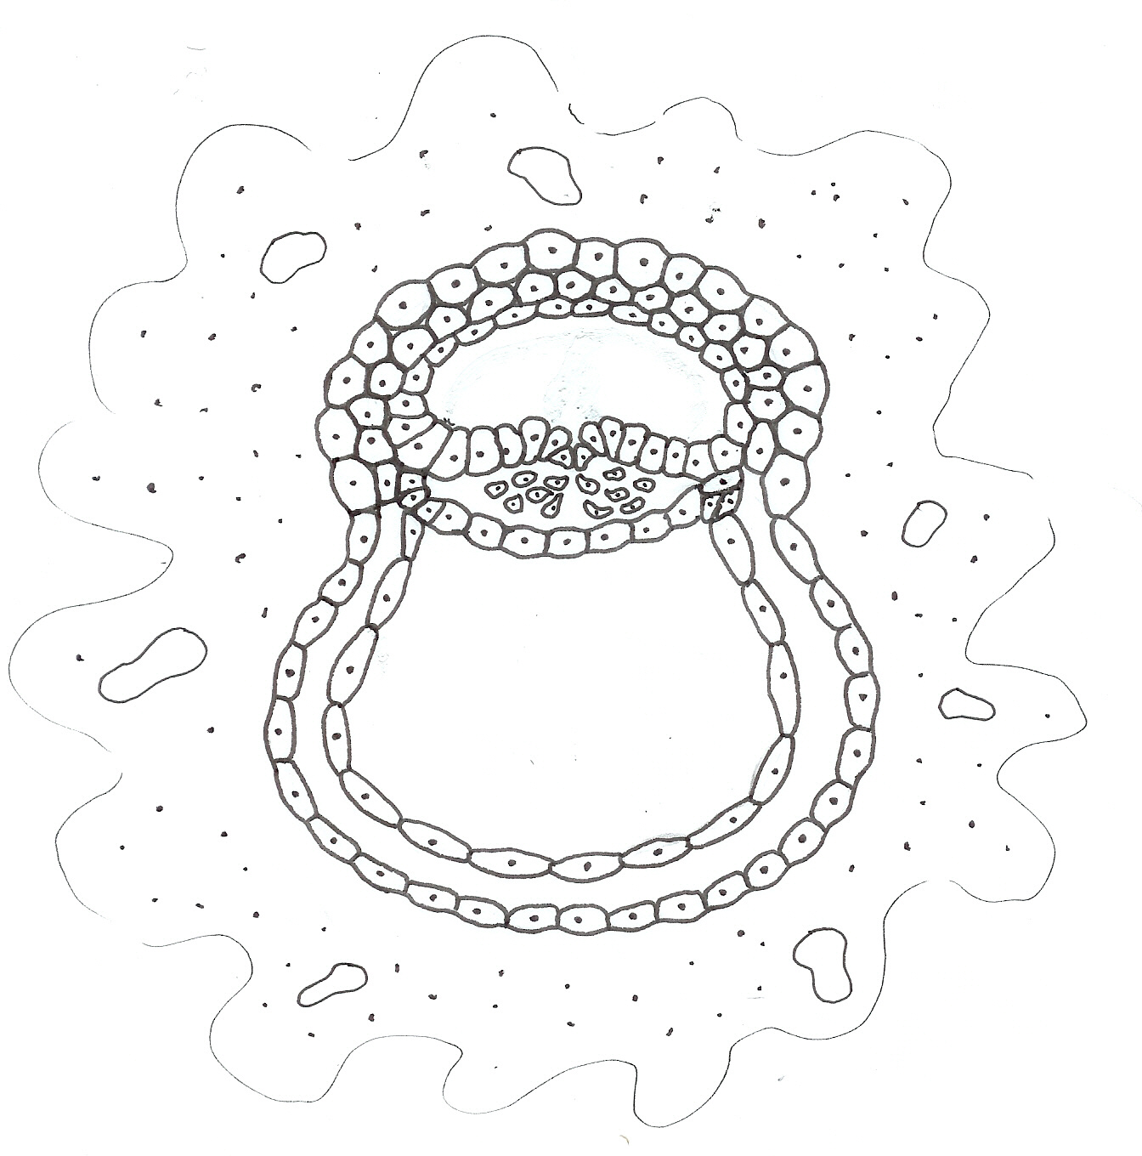
Structures derived from the primary germ layers
Ectoderm
Endoderm
Mesoderm

Slide 18
Embryonic Germ Layers
Are the layers that make up the embryonic disk
Are between pluripotent and multipotent:
  Each layer forms a range of different tissues.
Ectoderm:
  Upper layer of disk
  Forms skin, nails, eye, nervous system and brain, lining of respiratory & digestive systems
Mesoderm:
  Middle layer of disk
  Forms skeletal system, muscular system, cardiovascular system
Endoderm:
  Bottom layer of disk
  Forms lining tissues eg gut lining, ureter lining, etc.

Slide 19
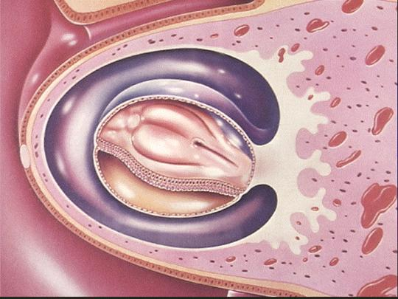
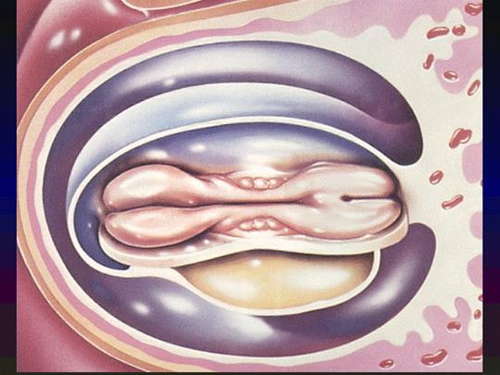
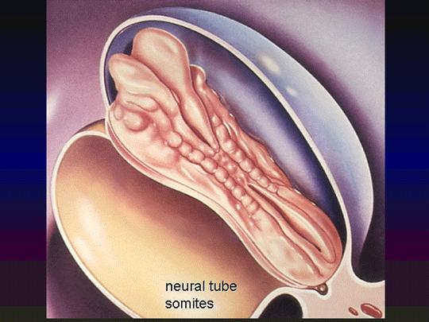
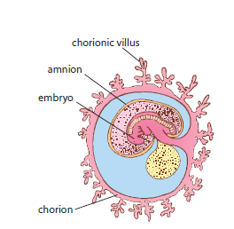
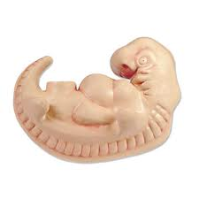
Development of the Embryonic Disc to form Embryo
As the cells divide and differentiate into tissues, the embryonic disc curls and folds to form the embryo:
Notes:
http://www.youtube.com/watch?v=UgT5rUQ9EmQ

Slide 20
salam
https://www.youtube.com/watch?v=SEejivHRIbE

